Slide 1
(IST 687: Final Project)
Health Management Organization
GROUP 3
Maitreyi Ahire(SUID: 830350745)
Priyanka Sheth (SUID: 730444482)
Manasi Rathi (SUID: 618023107)
Jainish Savaliya(SUID: 225038319)

Slide 2
Background
It's becoming increasingly crucial to precisely predict which individuals (customers) will be expensive using the available data, the case's main objective is to offer actionable insight
To do so, various factors must be investigated in order to compare which part of health industry is more expensive than others in general health care
We have analysed the primary characteristics that cause consumers to visit hospital more often or pay for hospital services

Slide 3
THE MAIN PROBLEM SPACE
Our main aim in this project is to identify specific reasons why some people's health care is more expensive than others', predict who's health care will be more expensive next year, and provide actionable insight to the HMO in terms of how to lower their healthcare costs with a specific recommendation

Slide 4
Initial Analysis
Dataset consists 7582 people with 14 different factors
Factors: X, age, bmi, children, smoker, location, location type, education level, yearly physical, exercise, married, hypertension, gender, cost
Data cleaning: removed null values from bmi and hypertension variables
Defined variable “expensive” based on cost. If cost is greater than 75% of the total cost frequency, we have considered it to be expensive
Data partition: Training data - 80% and testing data 20%

Slide 5
Deciding on our best model
Support vector machine(SVM) model: Accuracy: 86% and Sensitivity: 96.92%
Tree model : Accuracy: 89.12% and Sensitivity : 97.27%
Linear model: Accuracy: 42.3%

Slide 6
Understanding the reasons for expensive health care

Slide 7
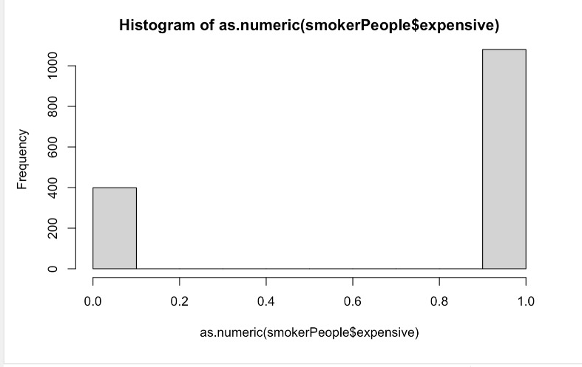
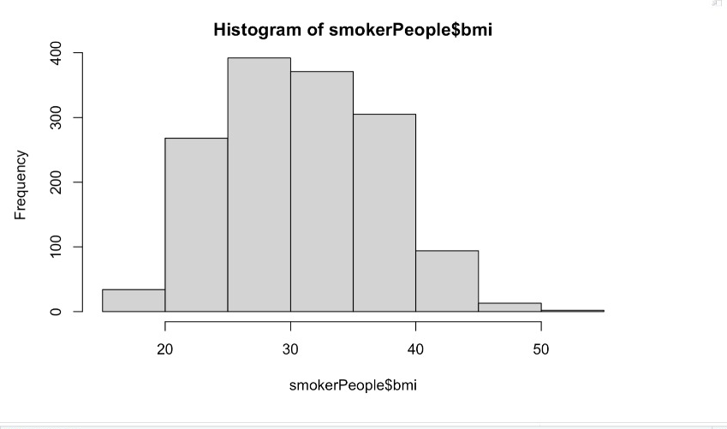
Smoker data analysis
Smokers vs Expensive people
Smokers vs BMI
Notes:
The histograms displays frequency of smokers based on expensiveness and bmi.
The left graph shows that most expensive people are smokers and has a frequency of 1000
The average BMI of a person is normally in the range 18-25, but as we can see in the right graph, majority people who smoke has a BMI of the range 25-30, thus their health is affected, thus expense increases

Slide 8
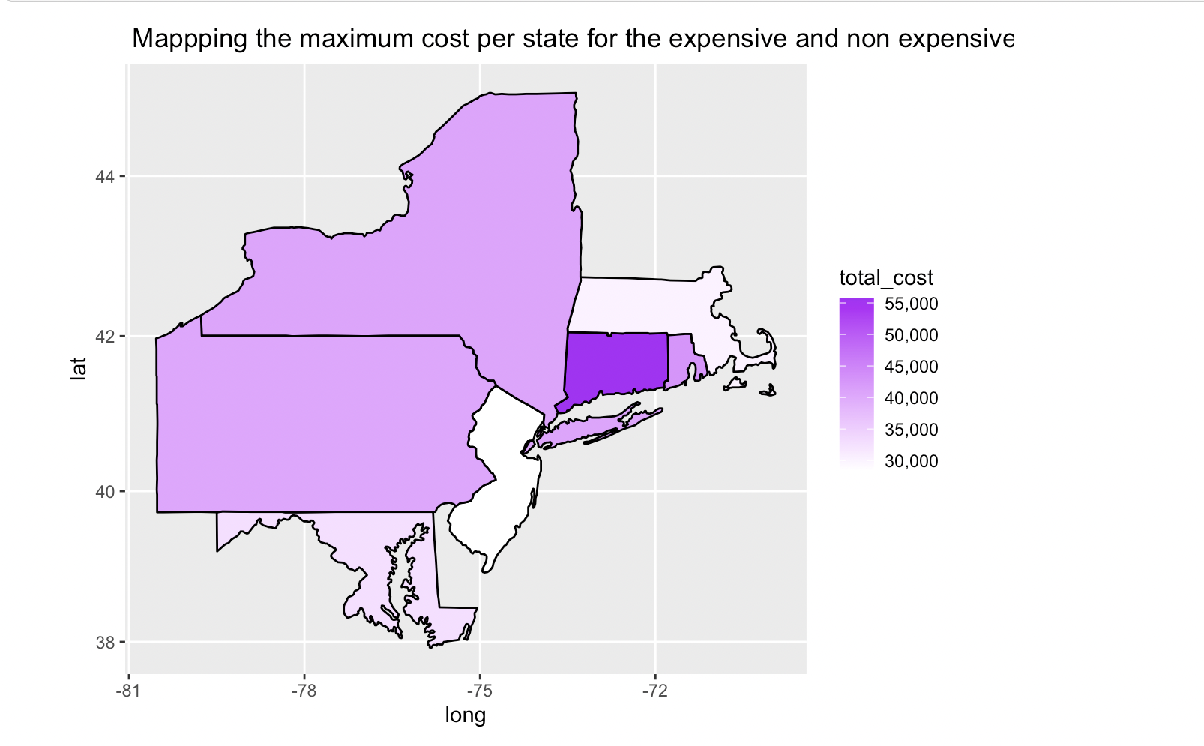
Mapping the maximum cost per state for the expensive and non expensive person
Notes:
Next, this maps shows out where healthcare has been utilised max, that is the maximum cost per state for expensive and non expensive people. Based on the map, we can see that the Highest cost is in CT(Connecticut), with a frequency of 55,000$

Slide 9
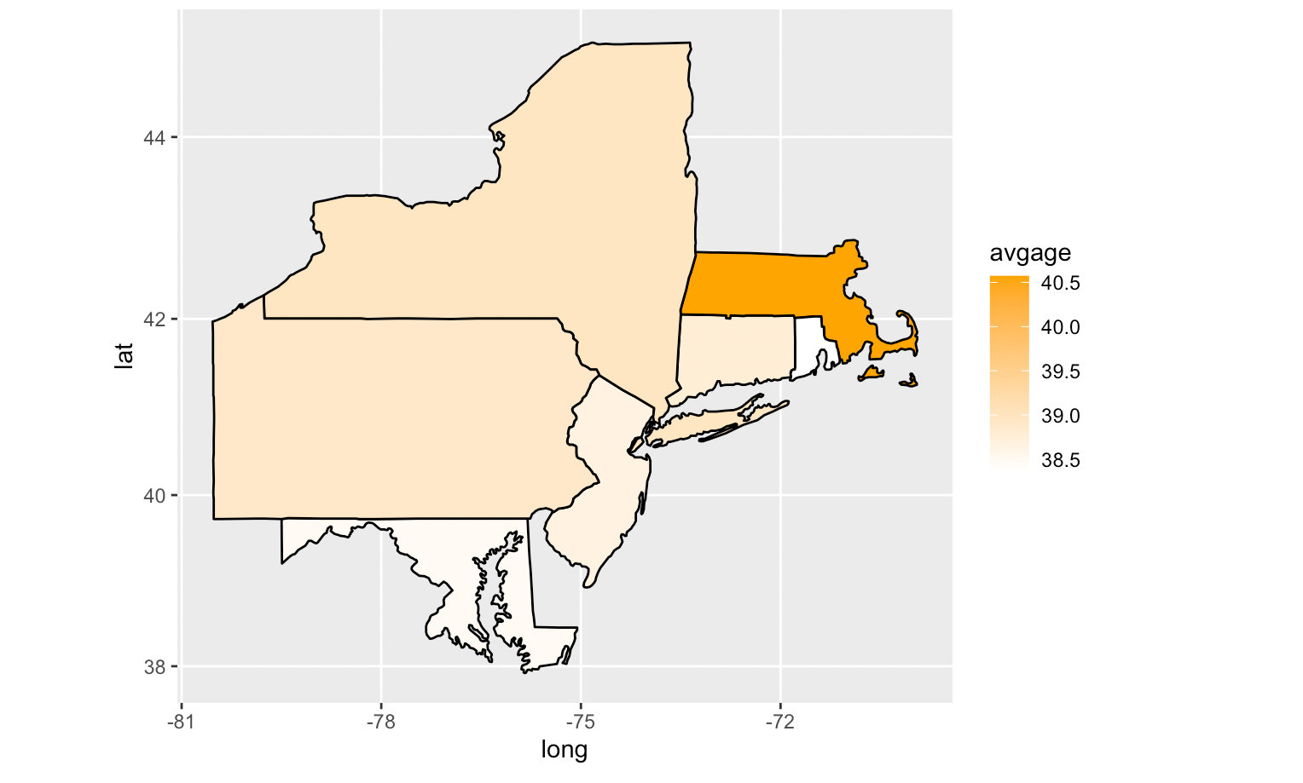
Mapping the age per state for the expensive and non expensive people on the basis of average age of people
Notes:
Later, we calculated the average age of people using healthcare and their location, based on the map, the Avg age is found in MA(Massachusetts) with a frequency of 40.5

Slide 10
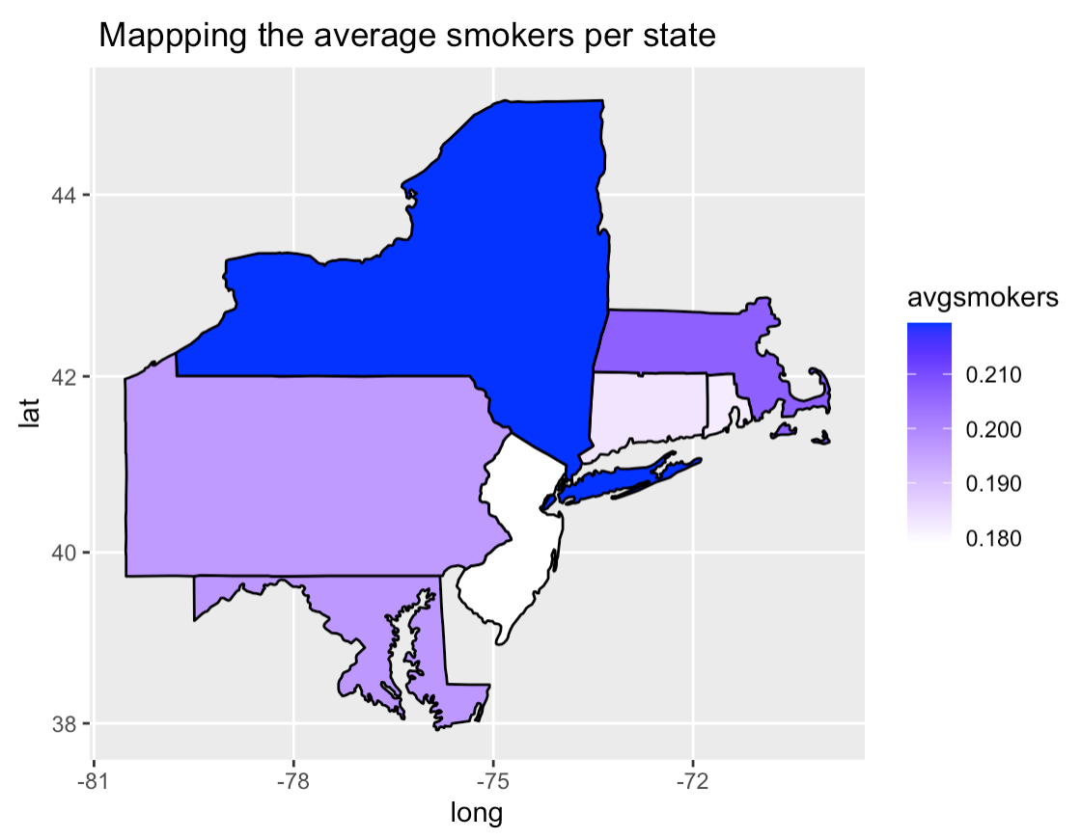
Mapping the average smokers per state
Notes:
Lastly, we mapped out to find the average number of smokers in the states, and based on the analysis NY has the avg smokers with a frequency of 0.210

Slide 11
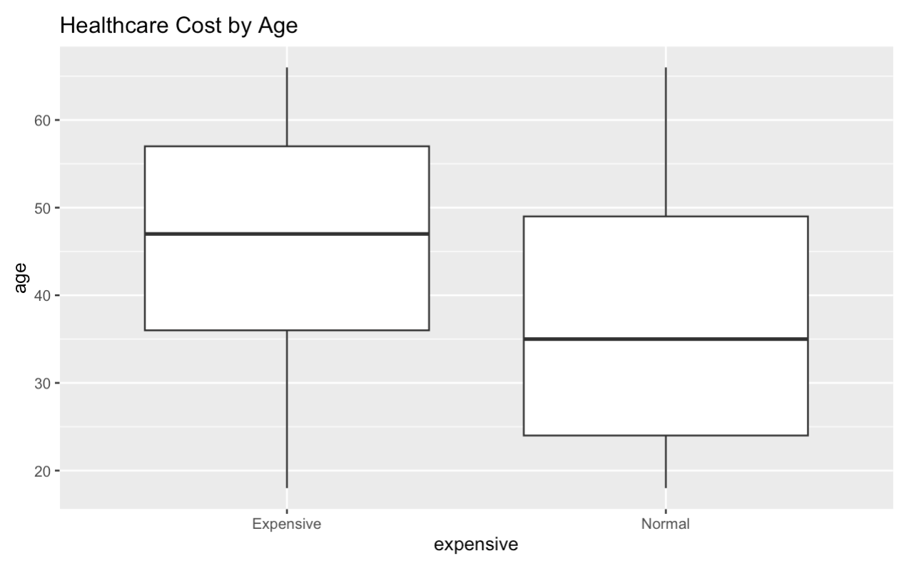
Boxplot for Healthcare Cost by age
Comparison of cost by age for Expensive and Normal People
Notes:
Cost by Age is greater for exp people as compared to normal people as the median for exp people is approx 52 while for normal people it is 35.

Slide 12
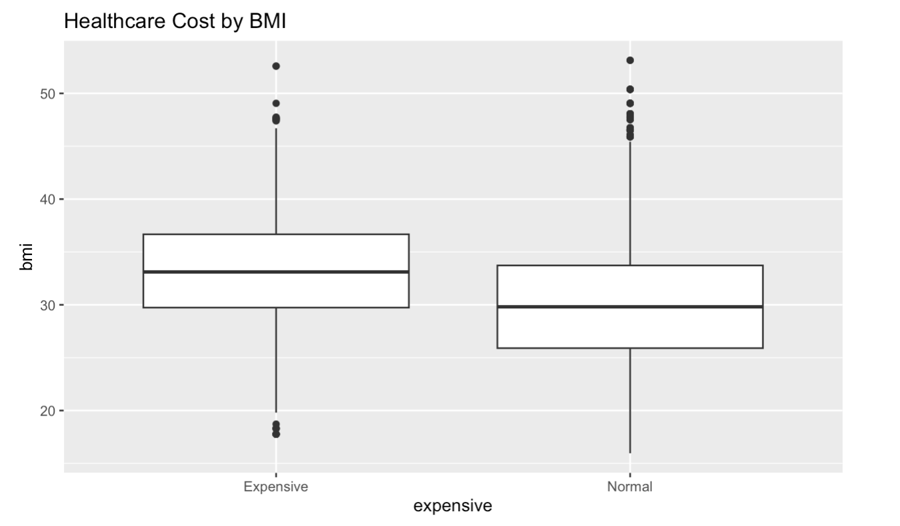
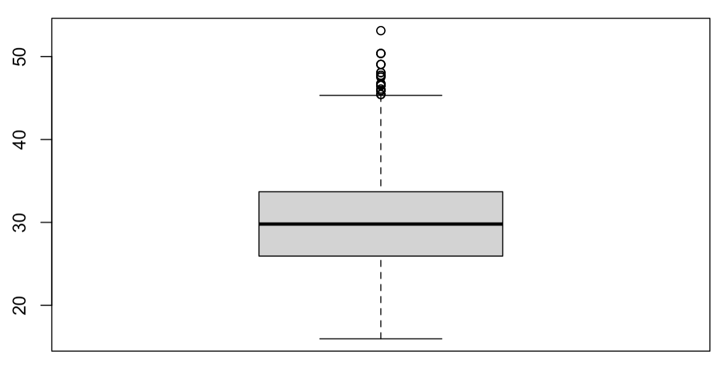
Boxplot for Healthcare Cost by BMI
Comparison of cost by bmi for Expensive, Inexpensive and Normal People
Notes:
Similarly, the cost by bmi for exp people is greater than normal , but the cost by bmi for inexpensive people is same as normal as their medians are similar.

Slide 13
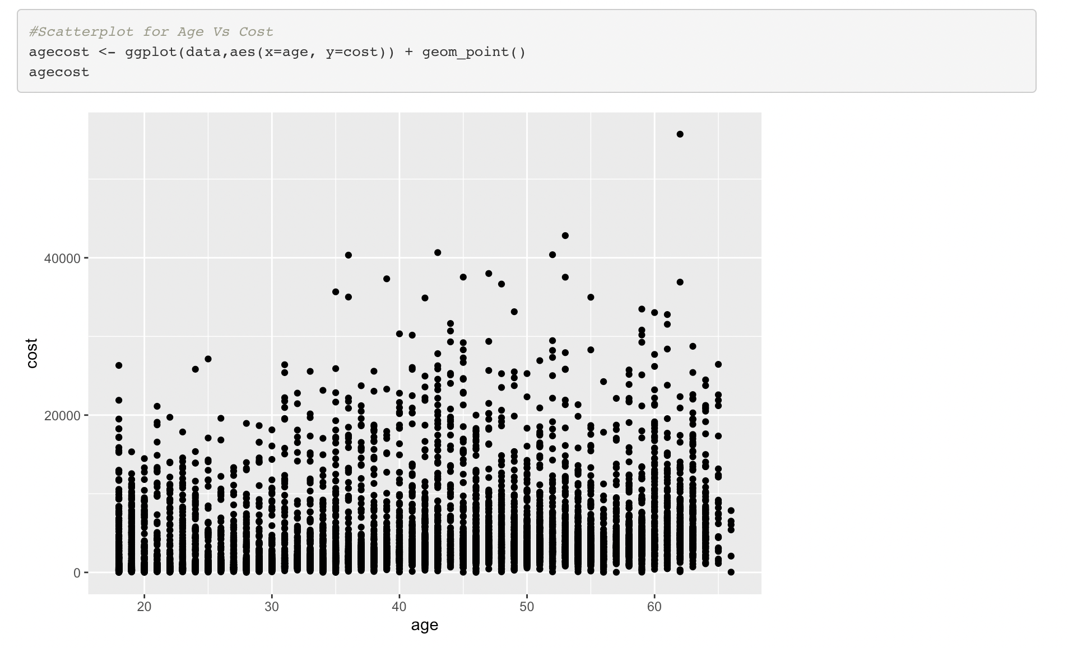
Scatterplot for Age VS Cost
From the below scatterplot for Age Vs Cost, we can observe that the scatterplot is populated highly from 0 to 12000 USD from 0 to 65 years old.
Notes:
For all age group, cost is 0-20000$

Slide 14
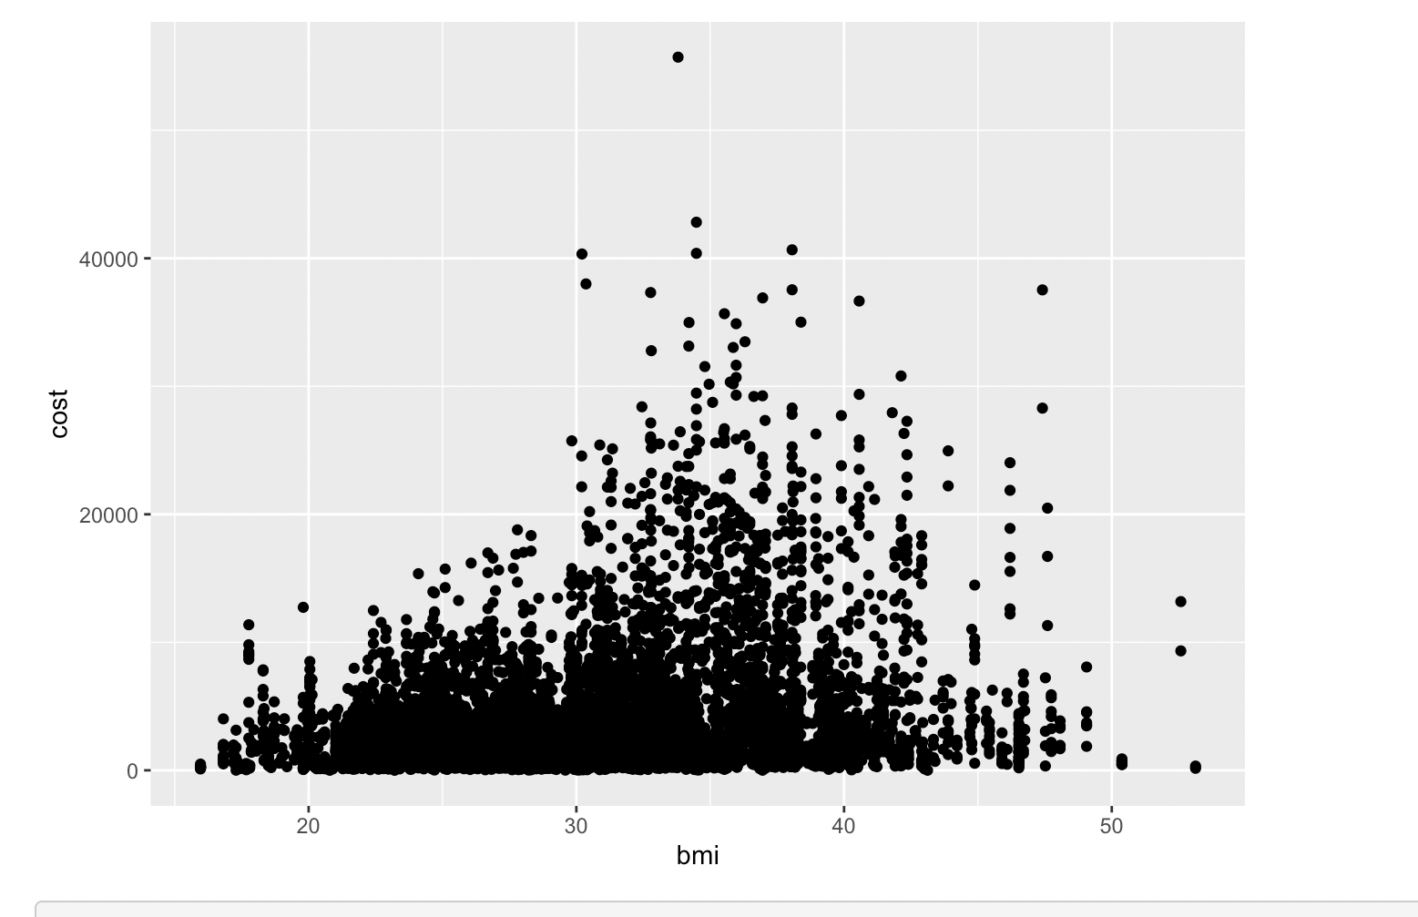
Scatterplot for BMI vs COST
From the below Scatterplot for BMI vs COST, we can observe that the frequency of the graph is highly populated from 20 to 35 bmi and 0 to 10000 USD
Notes:
Cost is majorly between the bmi 30-40

Slide 15
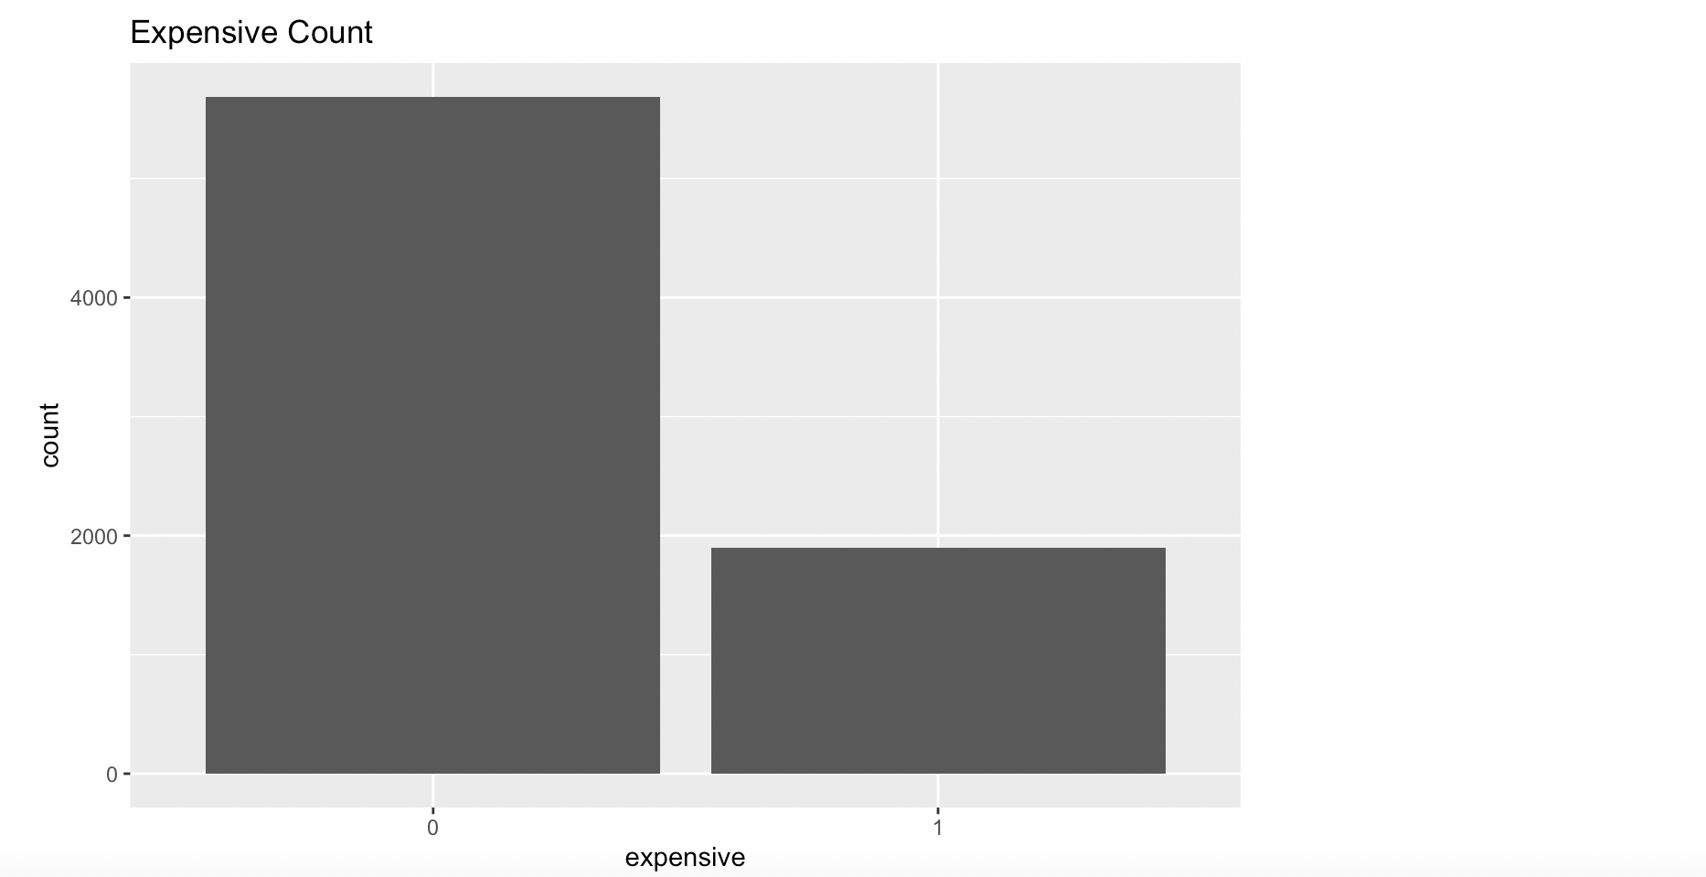
Barplot for expensive count
From the below bar plot, we can observe that number of expensive people count is around 1980

Slide 16
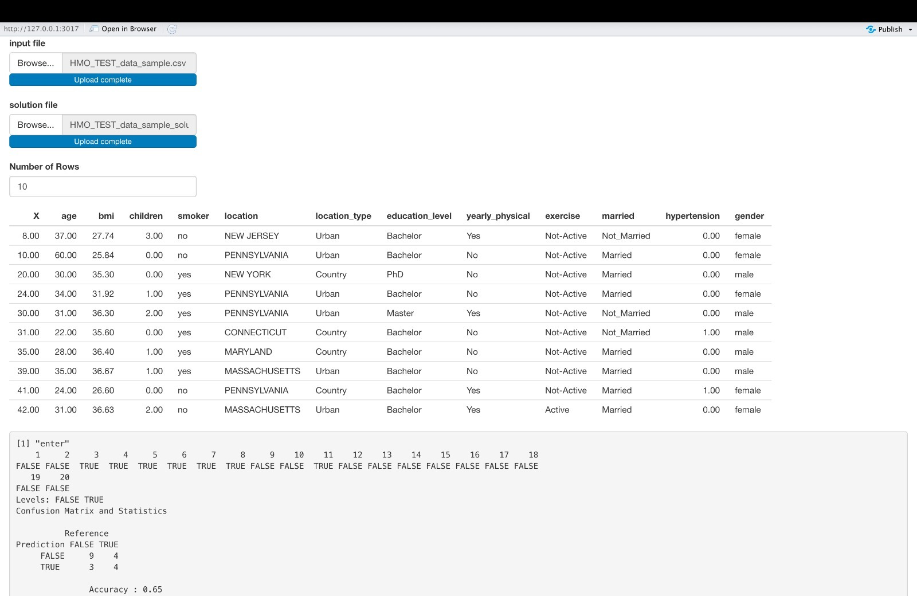
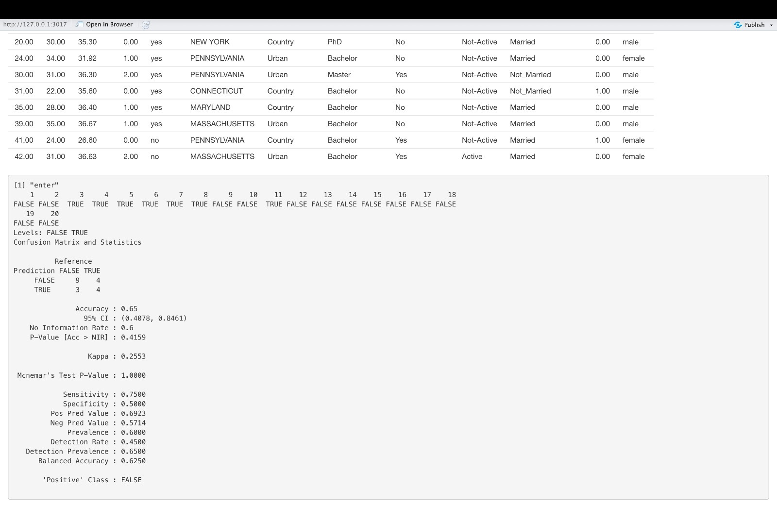
Shiny App

Slide 17
Recommendations
Based off of our analyses, we recommend three things to the HMO, with an emphasis on those who smoke.
Smokers should pay higher premiums. Retrospective of age, charging smokers a greater premium would help offset the high cost of healthcare because healthcare expenditures are significantly higher for smokers than non-smokers.
The premium ought to be significantly higher if you smoke in New York. The only state where healthcare costs were significantly higher than in another state was New York.
We don't need to charge more for someone with a high BMI if we already charge older folks with higher premiums due to their age. This is so because aging affects BMI more so than smoking does.

Slide 18
Scope Of the project
From the analysis done on the given data set we were able to identify reasons as to why people who pay more for health care services and also identify the root causes of expensive health care.
This project helped in understanding how we can reduce the healthcare prices, and also how we can make expensive people understand to adopt to good and healthy habits.

Slide 19
Thanks
Do you have any questions?

